Slide 1
(some of) What’s new in C#
Robert Barr
For the working developer

Slide 2








Robert Barr
@devrbarr
Connect with me on LinkedIn!

Slide 3
So what’s new …. in C#? … A LOT! We’ll be discussing the following
C# 6 | C# 7.0 | C# 7.1 | C# 7.2
Visual Studio 2015 | Visual Studio 2017 & .NET Core 1.0 | Visual Studio 2017 15.3 & .NET Core 2.0 SDK | Visual Studio 2017 15.5 & .NET Core 2.0 SDK
using static | Tuples | Inferred tuple element names | Leading underscores in numeric literals
String Interpolation | Pattern Matching
 | Numeric literal syntax
https://docs.microsoft.com/en-us/dotnet/csharp/whats-new/

Slide 4
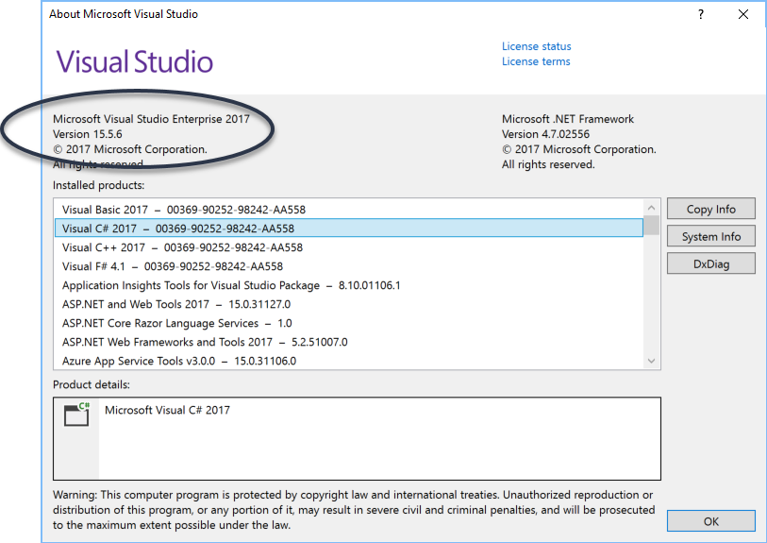
Help → About …

Slide 5


How do I get these new features?
NuGet Packages
Update Visual Studio: View → Notifications
https://docs.microsoft.com/en-us/visualstudio/install/update-visual-studio

Slide 6
Numeric Literals
Making code easier to read

Slide 7
Numeric Literals
Binary Literals
0b to indicate a binary number
Digit Separators
Use the _ (underscore) character to separate digits
Useful with:
long, double, decimal, float, int, uint, ulong

Slide 8
Numeric Literals
Recall:
- uint
- System Type: UInt32
- Size: 32 bits
- Value Range: 0 to 2^32-1
-ulong
- System Type: UInt64
- Size: 64 bits
- Value Range: 0 to 2^64-1

Slide 9
Numeric Literals
Demo

Slide 10
Pattern Matching
Figuring out who’s who and who’s what.

Slide 11
Pattern Matching
The is expression
The case clause in switch statements

Slide 12
Pattern Matching
Demos

Slide 13
Tuples
What the heck!?

Slide 14
Tuples
May need to add ValueTuple from NuGet or update VS 2017
Tuples are lightweight data structures that contain multiple fields to represent the data members (docs.Microsoft.com).
Store and return sets of data
Under the hood: Generic structs see System.ValueTuple<…>
Lots of syntactic sugar … can also be thought of as compiler magic
Tuples are value types containing mutable elements

Slide 15
Tuples
Demos

Slide 16
Next Steps
Keep learning … duh!!

Slide 17
Next Steps
Continue with new C# 7 features
Use ILSpy or ILDasm to view the IL and see what’s really going on here …

Slide 18
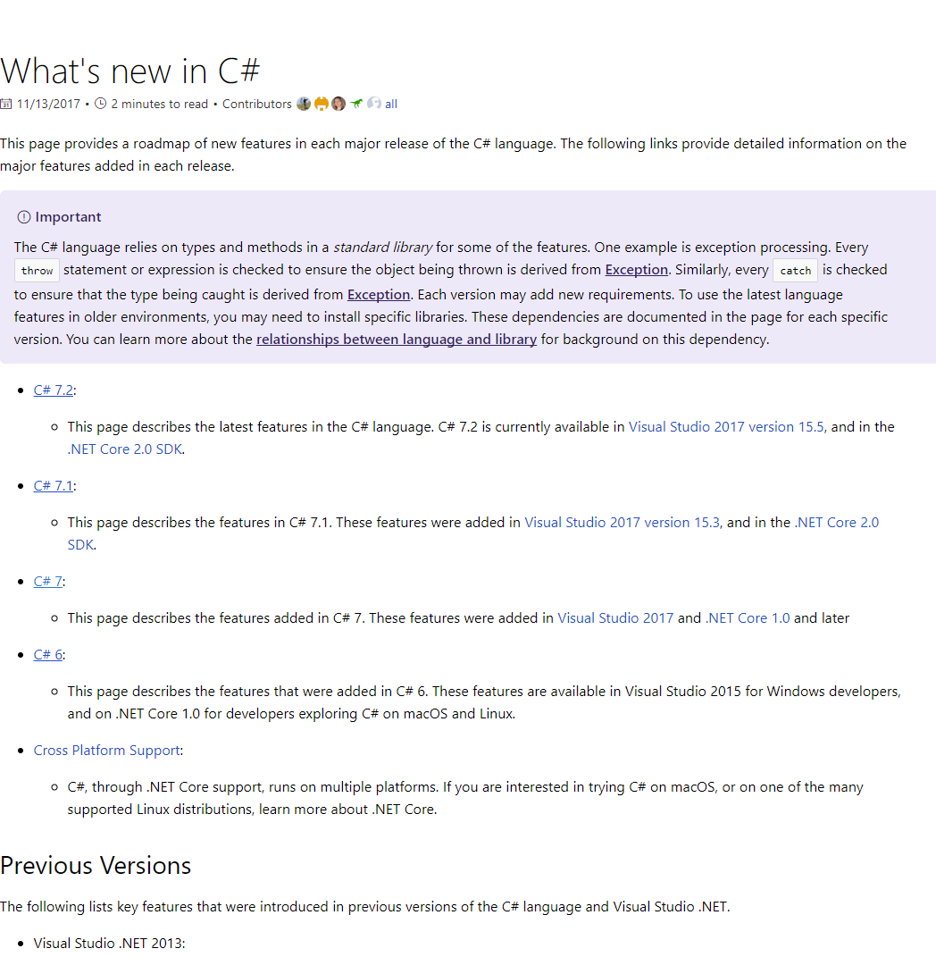
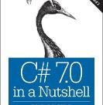
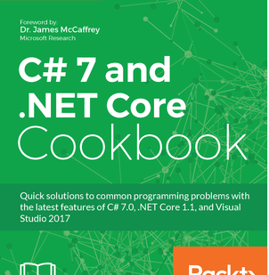
Resources
docs.Microsoft.com
C# 7.0 in a Nutshell
O’Reilly Books
C# 7 and .NET Core Cookbook
Packt Publishing

Slide 19
Robert Barr
@devrbarr
Connect with me on LinkedIn!

Slide 20
Thank you ☺
Robert Barr

